Slide 1

Trends and Keys to Successful Projects

Slide 2
What is KickStarter?
Crowdfunding platform for creative projects and merchandising

Slide 3

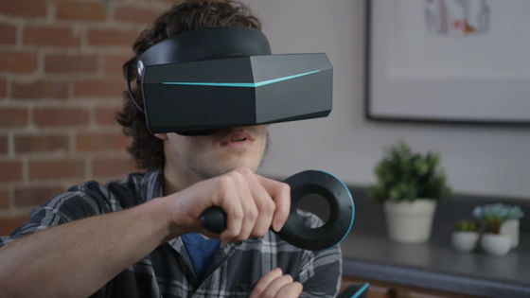

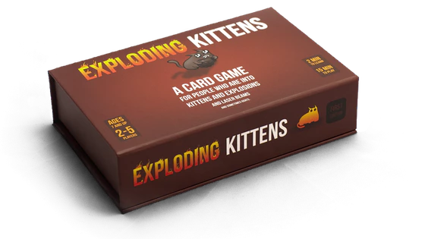
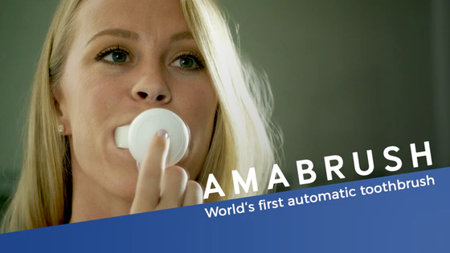
Successful Projects

Slide 4
How has KickStarter’s supply (projects)grown?

Slide 7
KickStarter Projects’ Factors of Success

Slide 8
KickStarter Projects’ Successful Categories

Slide 10
KickStarter Projects’ Price Sensitivity

Slide 11
Price Insensitive
Price Insensitive
Price Insensitive
Price Insensitive
Price Sensitive
Price Sensitive

